Slide 1

Evaluation of Position Resolution for a
Prototype Whole-Body PET Detector Based on Suppressing Backgrounds by Compton Scattering
Kento FUJIHARA, Yusaku EMOTO, Hiroshi ITO, Naomi KANEKO,
Hideyuki KAWAI, Shota KIMURA, Atsushi KOBAYASHI, and Takahiro MIZUNO
Dept. of Physics, Chiba University

Slide 2
Disclosure of Conflict of Interest
We have nothing to declare for this study.
The 113th Scientific Meeting of the Japan Society of Medical Physics
Notes:
2

Slide 3
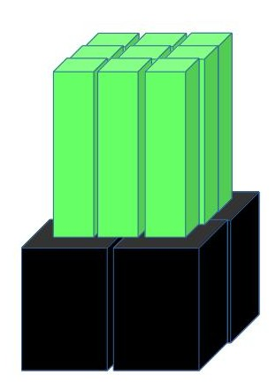
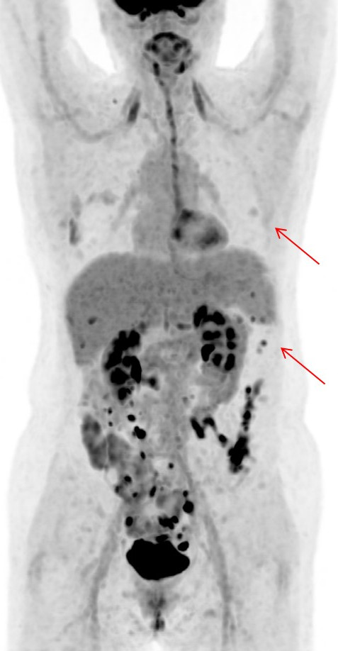
Introduction
Existing PET's resolution has been raised by splitting scintillation crystal.
However, recent PET's resolution is lower than expected by crystal size.
Scintillator
Crystal size : 5×4×25 mm³
Resolution : ~1 cm
Photo
detector
What makes PETs’ images unclear?
Notes:
最新PET：結晶サイズに比べて分解能があまりよくない
→原因は？
結晶サイズに対して分解能があまりよくない→原因は？

Slide 4
５１１ keV gamma-ray interactions are photoelectric absorption and Compton scattering.
In scintillator, Compton scattering occurs 4 times as much as photoelectric absorption.
Notes:
シンチレータ内では光電効果：コンプトン散乱＝1：4

Slide 5
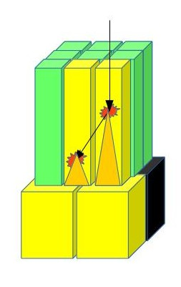
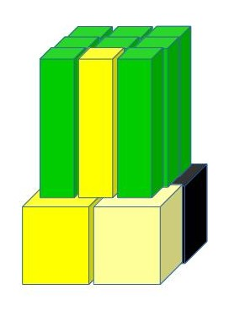
Required information is initial emission point, however...
Existing PET
・Centroid of energy deposit method
→ When Compton scattering occurs,
initial emission point is
misconceived.
↓
Distinguishing Compton scattering in scintillator is necessary to improve PET's resolution.
Initial emission
Common PET systems
  Unless distance between plural emission points is about 10 mm or more.
  they can't determine distinguish scattering event.
  They can't discriminate depth of emission point.
Notes:
分解能の低下は測定器内コンプトン散乱によるもの
これを判別する能力がPETには必要
測定器内散乱→重心演算で場所がずれる
散乱事象の判別が大事

Slide 6
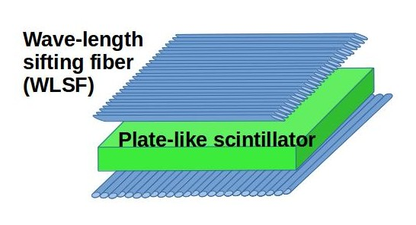
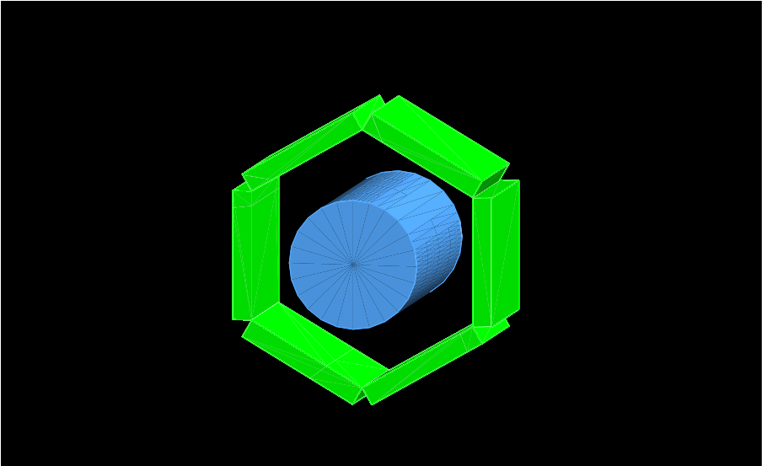
Purpose
Development of popular type PET which can cope with scattering in scintillator and is relatively inexpensive.
・Scintillator size is 300×300×1 mm³
・Top and bottom surface of scintillator is covered by dual sheets of WLSF (⌀0.2mm)
×24
Surround with 6 detectors
Light shade
Notes:
厚さ1mmのシンチレータに直径0.2mmの波長変換ファイバーを貼り付ける→PMTに接続

Slide 7
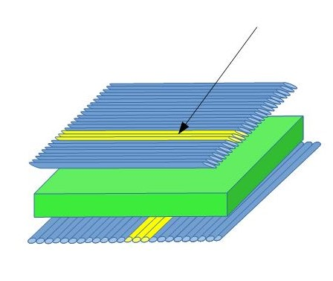
Measuring system
Gamma-ray is incident, and scintillator emits light.
↓
WLSFs reabsorb and emit light, and PMTs receive.
(Read the X and Y direction with the WLSF on the top and bottom respectively)
This system can...
distinguish scattering in scinttilator of 1 mm or more.
distinguish scattering in the depth direction because of plate-like scinttilator
(Since most of scattering is forward scattering, it is possible to make a more
stable image by adopting the emission point on the body side)
reduce cost of crystal processing and photodetector
Notes:
なったPMTから、入射場所のX・Yを直接読み出す
深さ方向も、何層目がなったかで把握可能

Slide 8
Aims of popular type PET
popular type PET
→ Used for periodic inspection of cancer prevention
for this purpose...
①Reducing the price (1~2 M$)
disctiminating cancer of at least 3 mm
②discriminating cancer of at least 3 mm
③Suppressing radiation exposure
（Now: 3~4 mSv at once
Natural exposure in Japan:2.1 mSv per year)

Slide 9
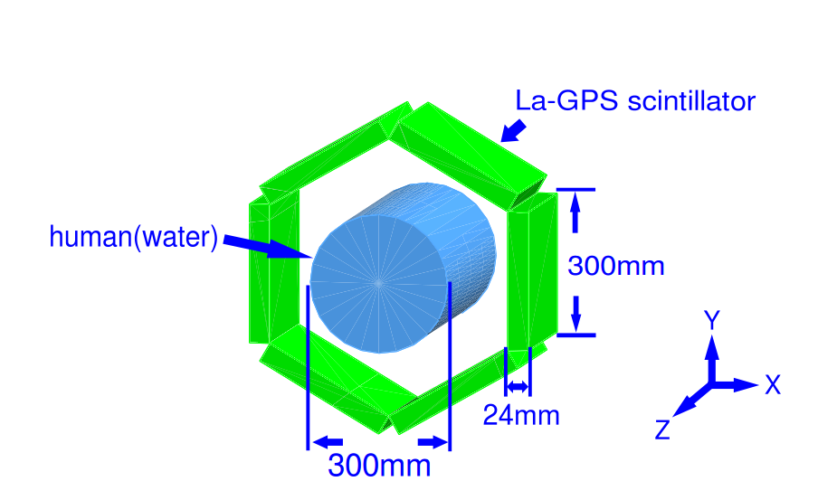
GEANT4 simulation
Change in image by discrimination of scattering event
setting①
・Physics list: FTFP_BERT
・Human: Tube of water (⌀300mm)
Detector:La-GPS［（Ce_{0.01}La_{0.24}Gd_{0.75}）₂ Si₂O₇］
(300×300×24 mm³)
Arrange in a hexagonal
columnar shape
・Resolution
Position（width）：0.2 mm
Position（depth）：1 mm
Energy：10%
Time：0（No deviation）

Slide 10
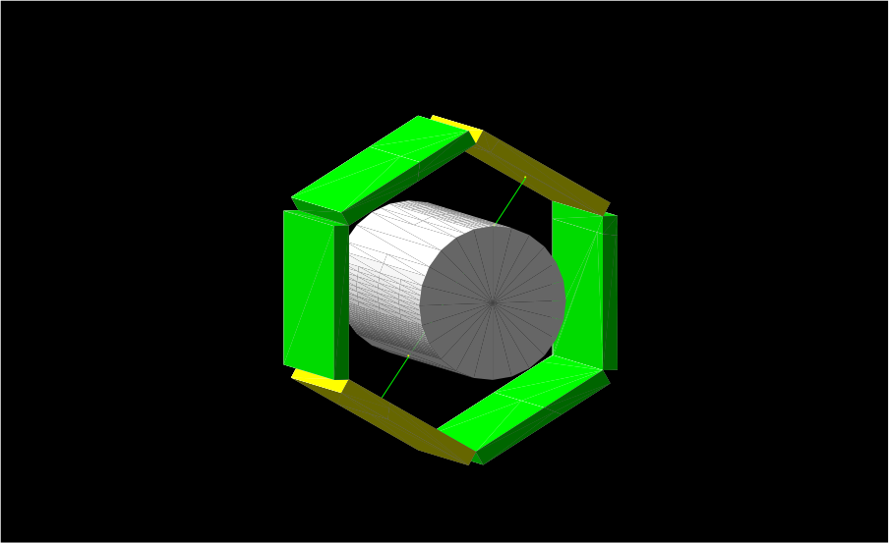
GEANT4 simulation
Change in image by discrimination of scattering event
setting②
・Generate positron at a point in the
human body defined by
a random number event by event.
(Equivalent to β＋ decay of ^{１８}F)
・distribution quantity of FDG:
In normal tissue: 2 MBq/kg
(3000 events/mm³)
・Set cancer in human, and
distribution quantity in cancer is
as five times as in normal tissue
Normal tissue 2MBq/kg
Cancer 10MBq/kg

Slide 11
GEANT4 simulation
Change in image by discrimination of scattering event
Reconstruct method
If energy deposit in two detector from 420 keV to 620 keV, analysis with the following three conditions.
①Adopt the centroid of energy if all emission
point falls within 10 mm
②Adopt the centroid of energy if all emission
point falls within 1 mm
③ ② + other events, adopt body side
lighting points
Based on the position and time of two points, put
one point per hiring event in the histogram
(Error is evaluated by square root of background intensity)
Adopting the centroid of energy if all emission point falls within Suitable range.
Time1
L1
Reconstructed point
L2
Time2
L1:L2=Time1:Time2
Notes:
①全発光点が10mm以内に収まる
②全発光点が1mm以内に収まる
③ ②+その他は体に最も近い発光点を採用

Slide 12
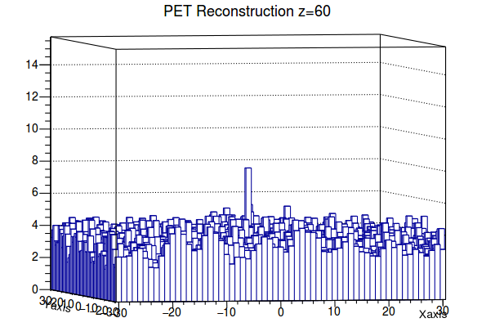
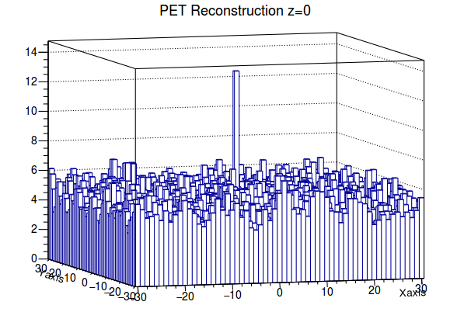
Simulation results①
Difference in image by z coordinate of the cancer
analysis with condition ②
・1×1×1 mm³ cancer on （0,0,60）
・1×1×1 mm³ cancer on （0,0,0）
Background：3.3 （σ＝1.8）
Cancer ：4.6 （2.6σ）
Background：4.9 （σ＝2.2）
Cancer ：8.5 （3.9σ）
SNR is better when the z coordinate of the cancer is closer to the center of the detector.
Notes:
バックグラウンド強度：一様に広がっている部分の高さ
がん部分強度：がんの場所がバックグラウンド強度からどれだけ伸びているか

Slide 13
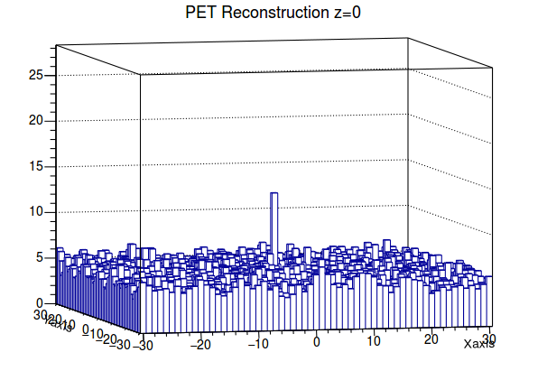
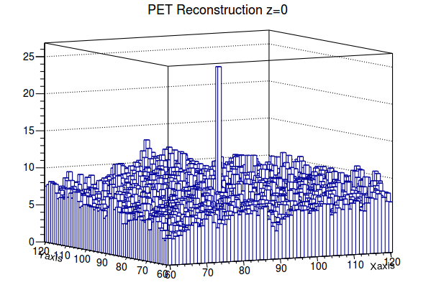
Simulation results②
Difference in image by x-y coordinate of the cancer
analysis with condition ②
・1×1×1 mm³ cancer on （0,0,0）
・1×1×1 mm³ cancer on （90,90,0）
Background：4.9 （σ＝2.2）
Cancer ：8.5 （3.9σ）
Background：6.5 （σ＝2.5）
Cancer ：18 （7.2σ）
SNR is better when the x-y coordinates of the cancer are closer to the outside of the body.
Together with ①、Resolution is poor at the center of the body and where the z coordinate is away from 0.

Slide 14
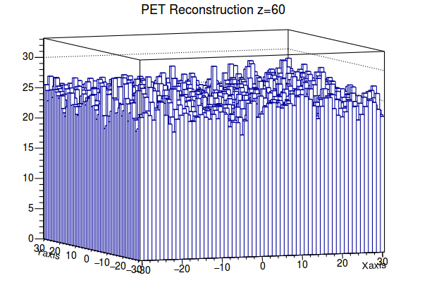
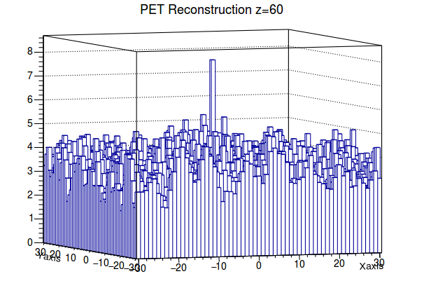
Simulation results③
Difference in image by rejection of scattering event
1×1×1 mm³ cancer on （0,0,60）
・analysis with condition ①
・analysis with condition ②
Background：25 （σ＝5）
Cancer ：5 （1σ）
Background：3.3 （σ＝1.8）
Cancer ：4.6 （2.6σ）
In condition ②, cancer signal level is more than 2σ.
By discriminating and rejecting scattering events, the image becomes clear.

Slide 15
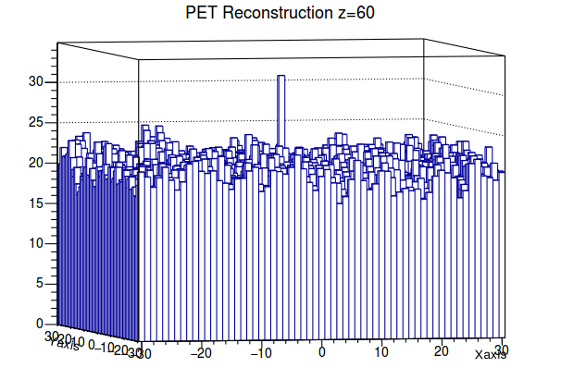
Simulation results④
Difference in image by adoption of body side emission
1×1×1 mm³ cancer on （0,0,60）
・analysis with condition ②
・analysis with condition ③
Background：3.3 （σ＝1.8）
Cancer ：4.6 （2.6σ）
Background：20 （σ＝4.8）
Cancer ：12 （2.5σ）
By adopting the body side emission, the statistical amount is increased, and a more stable image can be created. However, it is not as clear as expected because the background level is high.

Slide 16
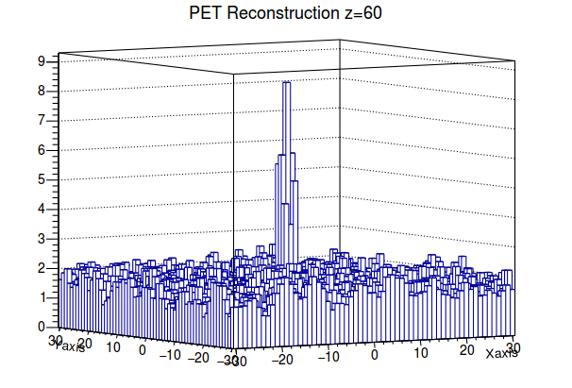
Simulation results⑤
Reconstructed image when medicine amount decreased
3×3×3 mm³ cancer on （0,0,60）
Set amount of medicine (= number of events) to 1/2
・analysis with condition ②
Background：1.7 （σ＝1.3）
Cancer ：4.3 （3.3σ）
If cancer is about 3 mm, 2σ can be achieved with less drug amount
→ It is possible to reduce exposure dose

Slide 17
Conclusion
・Discriminating scattering in detector is indispensable for improving the resolution of PET images.
・Detectors based on plate-like scintillator and WLSF are suitable
for discriminating scattering in the width and depth directions,
which also contributes to cost reduction.
・As a result of the simulation, for cancer of 1 mm in size, a more
clear image is obtained by adopting the emission point on the
body side.
For cancers 3 mm in size, it was confirmed that the amount of the
medicine can be suppressed to about one half by rejecting the
scattering Event.

Slide 18
Reference
[1]Berger M J; Hubbell J H; Seltzer S M; Chang J; Coursey J S; Sukumar R; Zucker D S;
Olsen K: NIST XCOM: Photon Cross Section Database
http://physics.nist.gov/PhysRefData/Xcom/html/xcom1.html
(retrived on the 8th of December 2016)

