Slide 1
Proposal for Dosimetry System Using e⁺/e⁻ Pair Production Events
Shota KIMURA, Yusaku EMOTO, Kento FUJIHARA, Hiroshi ITO, Naomi KANEKO, Hideyuki KAWAI,
Atsushi KOBAYASHI, and Takahiro MIZUNO
Graduate School of Science, Chiba University
Notes:
電子陽電子対生成事象を利用した生体内被ばく線量分布測定器の提案

Slide 2
Disclosure of Conflict of Interest
We have nothing to declare for this study.

Slide 3
About particle beam therapy
Cancer treatment
Accelerate protons or the nucleus of carbon or oxygen with an accelerator and hit cancer cells
The number of patients is increasing.
Notes:
粒子線治療は近年注目されているがん治療法である。陽子や炭素、酸素の原子核を加速器で加速してがん細胞に当て、がん細胞を殺すという治療法である。

Slide 4
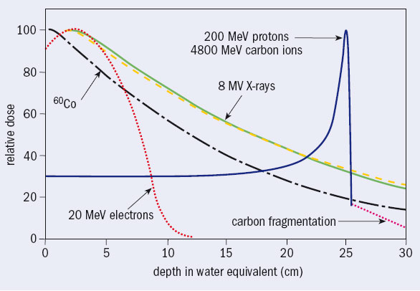
Benefits of particle beam therapy
The effect becomes enormous only when the particle stop.
Give large damage only to cancer cells.
Relative dose of various radiations in the body^{[2]}
Notes:
粒子線は止まる直前に大きなエネルギーを落とす。つまりがん細胞にだけ大きなダメージを与えることができる。

Slide 5
Risks of particle beam therapy
If the position to hit the beam is incorrect, it will damage only normal cells and cannot damage cancer cells.
It is necessary to monitor the position where the beam is hit in real time.
Notes:
粒子線治療では、ビームを当てる位置を間違えると正常細胞にだけダメージを与えて、がん細胞にはダメージを与えられないということが起こりうる。したがって、ビームがどこにあたっているのかをモニターすることが必要である。

Slide 6
Previous Research^{[3]}
PET (Positron Emission Tomography)
Using 0.511 MeV gamma rays emitted when positron annihilate
Compton Camera
Capture gamma rays of 2.3 MeV / 0.718 MeV with a Compton camera.
Combine with data obtained by PET detector to construct an image.
Notes:
PET装置やコンプトンカメラを用いた方法が研究されている。

Slide 7
Simulation of energy and position distribution of gamma ray generated by particle beam therapy
GEANT4, Monte Carlo simulation code
Beam Energy
Carbon beams…290 MeV/n
Proton beams…175 MeV
Material of the phantom
G4_MIX_D_WAX (H:13.4%, C:77.8%, O:3.5%, Mg:3.9%, Ti:1.4%)
Physics List
FTFP_BERT_HP+G4RadioactiveDecayPhysics (Carbon beams)
QGSP_BIC_HP+G4RadioactiveDecayPhysics (Proton beams)
Shot 10⁷ particles

Slide 8
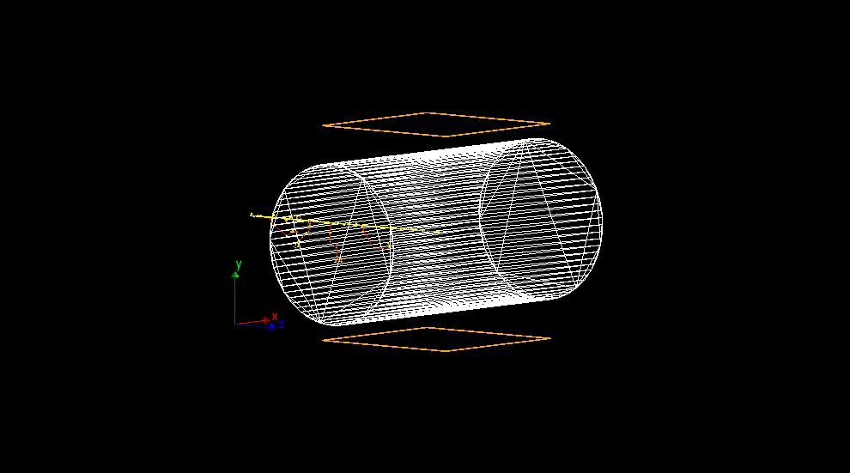
Simulation flow
Shoot beams
Acquired data
Gamma ray’s last scattered point in the body
Gamma ray’s position, momentum direction and energy on the surface of the body
Gamma rays entering detecting area (30 cm*30 cm, located 5 cm from the body, orange square in the picture) are extracted

Slide 9
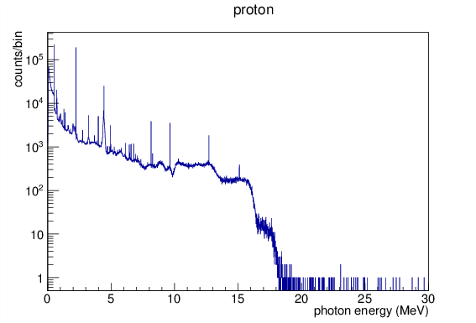
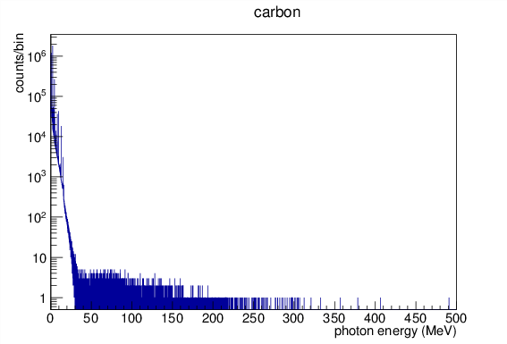
Energy distribution of gamma rays
Carbon beams
Proton beams
Maximum ~500 MeV
About 98% is less than 10 MeV
Maximum ~30 MeV
Peak @0.511 MeV
Pair annihilation of e⁺
Peak @2.24 MeV
Bond energy of deuterium

Slide 10
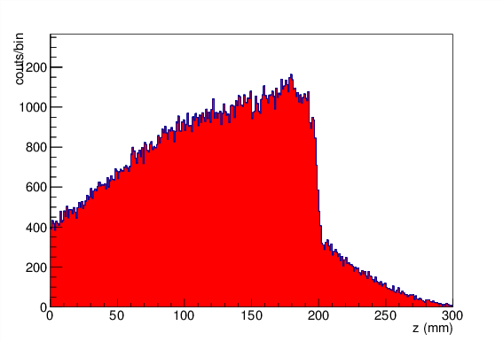
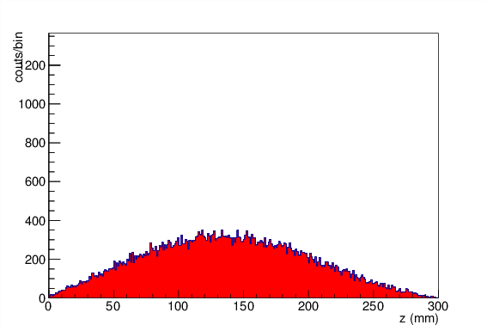
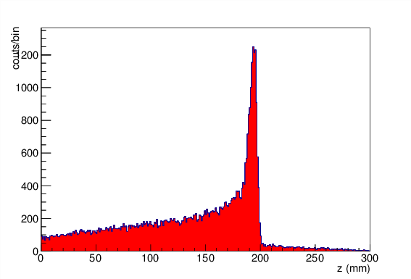
Distribution in the z direction (traveling direction) of gamma ray generation position (per 10⁷ protons)
0.511 MeV (0.420-0.602 MeV)
1-5 MeV (except 2.2-2.3 MeV)
Proton beam
1 hour
1 min
1 sec
2.2-2.3 MeV
Over 10 MeV

Slide 11
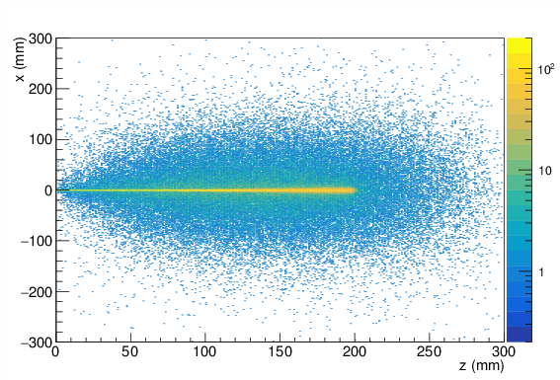
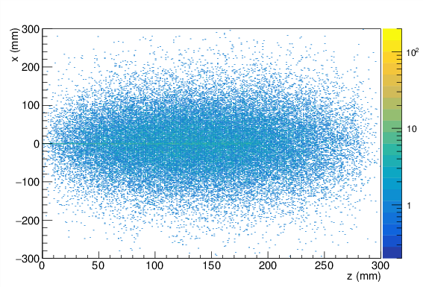
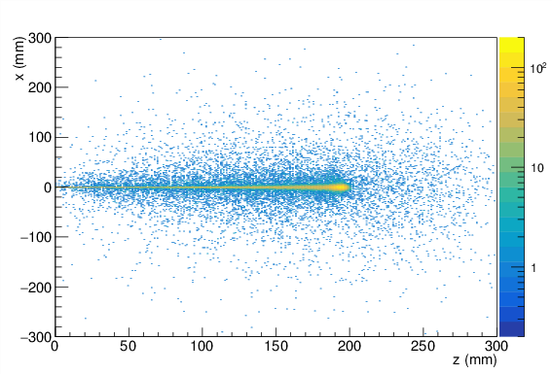
z-x plane distribution
0.511 MeV (0.420-0.602 MeV)
1-5 MeV (except 2.2-2.3 MeV)
Proton beam
1 sec
2.2-2.3 MeV
Over 10 MeV

Slide 12
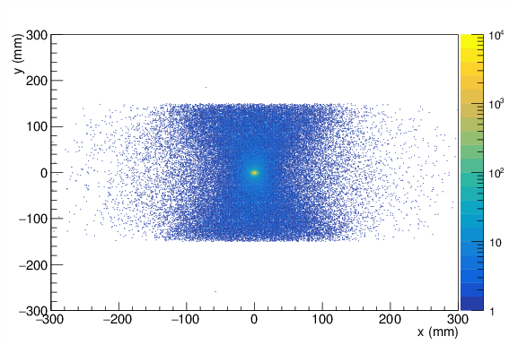
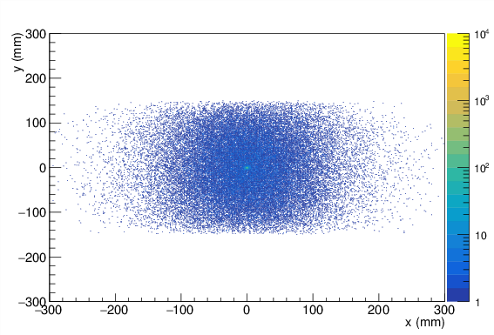
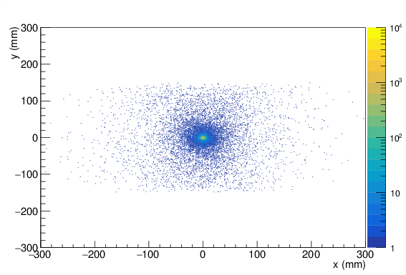
x-y plane distribution
0.511 MeV (0.420-0.602 MeV)
1-5 MeV (except 2.2-2.3 MeV)
⦿ Proton beam
1 sec
2.2-2.3 MeV
Over 10 MeV

Slide 13
Summary of proton beam irradiation simulation
The source (final scattering position) of 0.511 MeV gamma rays is widely distributed in the body
When trying to see with 0.511 MeV gamma ray, it is necessary to wait for a long time from beam irradiation
Generating position of 2.2-2.3 MeV gamma rays is widely distributed in the body, and there is no relation between generating position and the Bragg peak position
Generation position of 1-5 MeV gamma rays is also widely distributed in the body
Easier to distinguish the Bragg peak position than using 0.511 MeV gamma ray
Gamma rays over 10 MeV are generated intensively from the Bragg peak position
Notes:
0.511 MeV, 2.2-2.3 MeV, 1-5 MeVのガンマ線の発生位置は体内に広く分布している。また、2.2-2.3 MeVガンマ線の発生位置はブラッグピーク位置と何の関係もない。1-5 MeVガンマ線を使えば、0.511 MeVのガンマ線よりはブラッグピークの位置を確認しやすい。一方で、10 MeV以上のガンマ線はブラッグピーク位置から集中的に発生している。

Slide 14
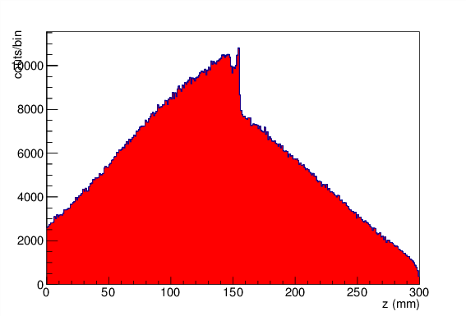
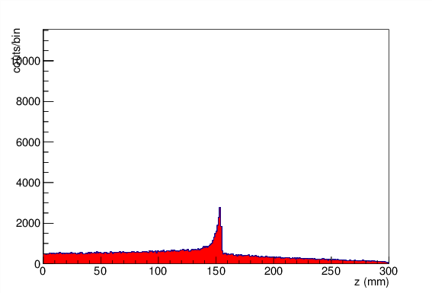
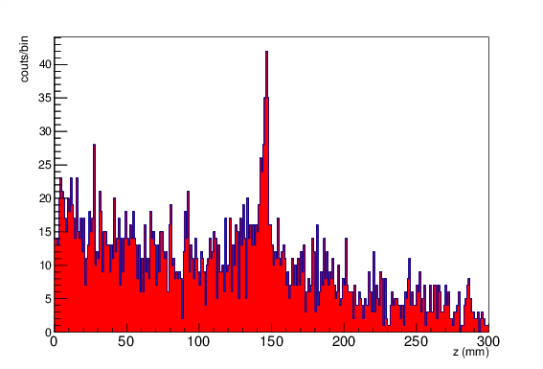
Distribution in the z direction (traveling direction) of gamma ray generation position (per 10⁷ carbons)
0.511 MeV (0.420-0.602 MeV)
1-5 MeV (except 2.2-2.3 MeV)
Carbon beam
1 hour
1 min
1 sec
Over 10 MeV
Over 20 MeV

Slide 15
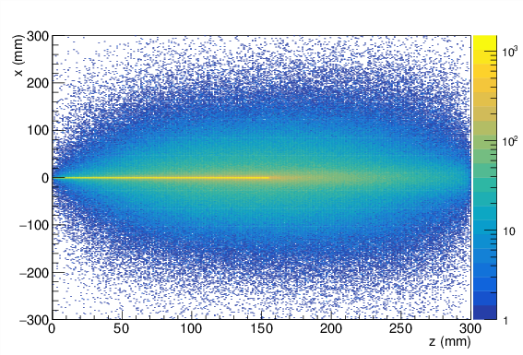
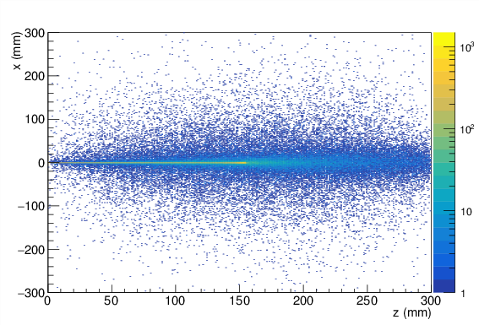
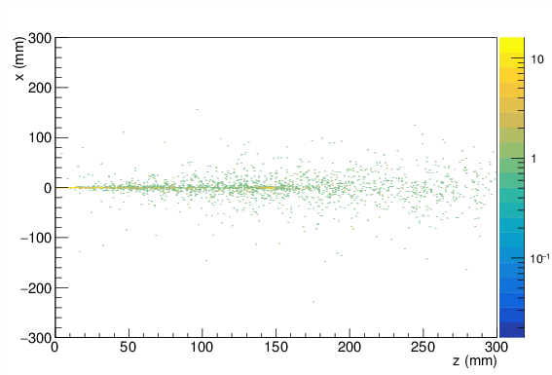
z-x plane distribution
0.511 MeV (0.420-0.602 MeV)
1-5 MeV (except 2.2-2.3 MeV)
Carbon beam
1 sec
2.2-2.3 MeV
Over 10 MeV

Slide 16
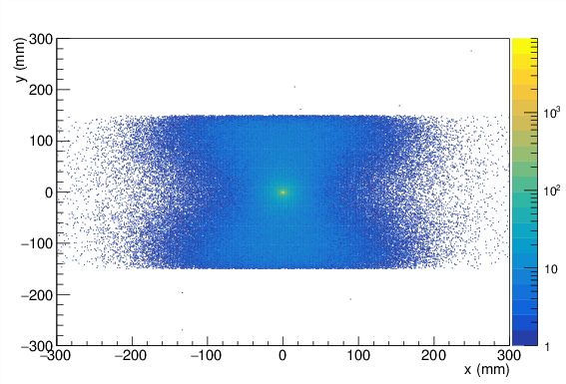
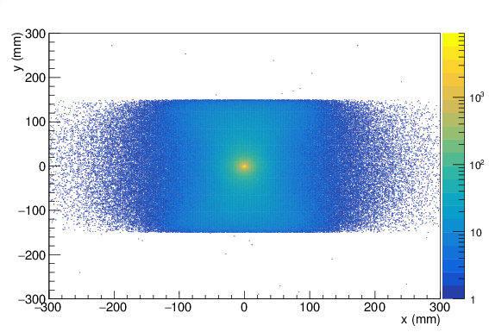
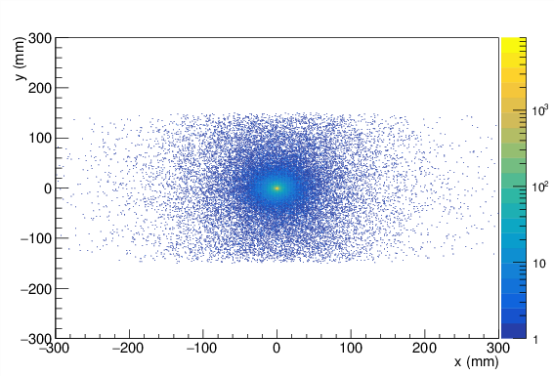
x-y plane distribution
0.511 MeV (0.420-0.602 MeV)
1-5 MeV (except 2.2-2.3 MeV)
⦿ Carbon beam
1 sec
2.2-2.3 MeV
Over 10 MeV

Slide 17
Summary of carbon beam irradiation simulation
High energy (>20 MeV) gamma rays are also generated, and such gamma rays are generated along the beam.
Although the number of high energy gamma rays is small, sufficient data amount can be expected for 10⁹ carbons.
Notes:
20 MeV以上の高エネルギーガンマ線も発生しており、そのようなガンマ線はビームに沿って発生する。そのようなガンマ線の数は少ないが、10^9炭素に対しては十分なデータ量が得られることが期待できる。

Slide 18
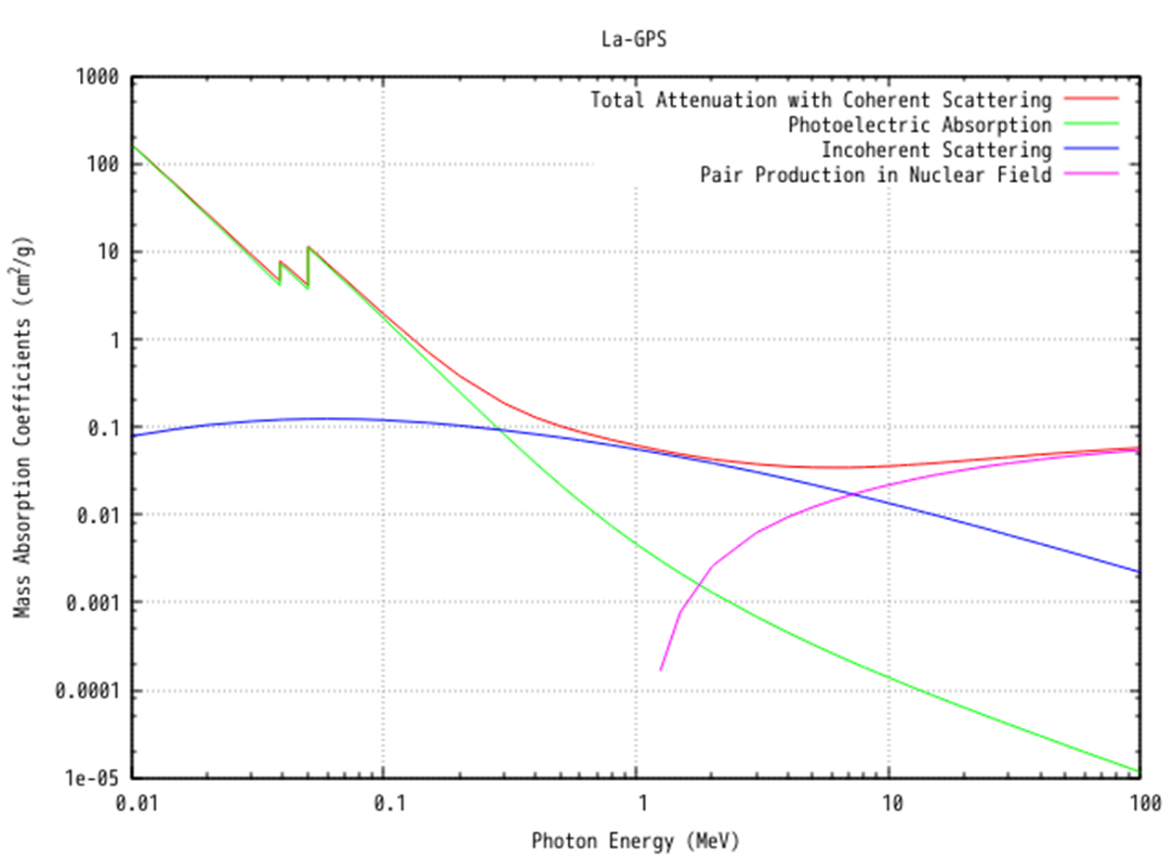
Cross section of gamma rays^{[4]}
Cross section between La-GPS ((Gd_{1-x}La_{x-y}Ce_{y})₂Si₂O₇ x=0.25, y=0.01) and gamma ray^{[5]}
Pair production events are dominant when gamma ray’s energy is over 10 MeV
Notes:
シンチレータ材料の一つであるLa-GPSとガンマ線の反応断面積を示す。10 MeV以上の領域では対生成事象が支配的になるため、対生成事象を用いた検出器が必要である。

Slide 19
Proposal of new system
Using pair production events
Details of the system is omitted because this system is now preparing for patent applications
Notes:
対生成を用いた検出器であるが、現在特許出願準備中のため、詳細は割愛する。

Slide 20
Conclusions
At the Bragg peak position, high energy gamma rays are generated, and such gamma rays are generated along the beam.
By using such gamma rays, Bragg peak position can be monitored accurately and easily.
Notes:
ブラッグピーク位置からは高エネルギーのガンマ線が発生しており、そのようなガンマ線はまたビームに沿って発生している。そのようなガンマ線を使えば、ブラッグピーク位置を正確に、わかりやすくモニターすることが可能になる。

Slide 21
References
公益財団法人医用原子力技術研究振興財団: 各粒子線施設における治療の登録患者数 （年度別） http://www.antm.or.jp/05_treatment/info/ryuusisen-kanja_2014.pdf (retrieved on the 25th of Feb. 2017)
Amaldi U and Kraft G: Particle accelerators take up the fight against cancer CERN COURIER 46(10) (2006) http://cerncourier.com/cws/article/cern/29777 (retrieved on the 1st of Dec. 2016)
西尾禎治: 陽子線がん治療における原子核反応の重要性 http://www.rcnp.osaka-u.ac.jp/~mhfukuda/Workshop/NeutronADS/NeutronADS/Welcome_files/Nishio_ProtonTherapy.pdf (retrieved on the 27th of Feb. 2017)
Berger M J; Hubbell J H; Seltzer S M; Chang J; Coursey J S; Sukumar R; Zucker D S; Olsen K: NIST XCOM: Photon Cross Section Database http://physics.nist.gov/PhysRefData/Xcom/html/xcom1.html (retrieved on the 1st of Dec. 2016)

