Slide 1

Development of gamma-detectors for PET with position resolution of 0.5 mm
O-041
Y Emoto, K Fujihara, H Ito, N Kaneko, H Kawai, S Kimura, A Kobayashi, and T Mizuno
Graduate School of Science, Chiba University, Japan
Notes:
演題番号：O-041
演題名 ：位置分解能0.5mmのPETγ線測定器の開発

Slide 2
We have nothing to declare for this study.
If you have no disclosure, please use this as the second slide (next to title slide).
Disclosure of Conflict of Interest
The 113th Scientific Meeting of the Japan Society of Medical Physics

Slide 3
Basic method to improve the position resolution of PET
In the Positron Emission tomography (PET), positrons and electrons annihilate and pairs of gamma-rays are created. These gamma-rays are caught by the scintillators of the detectors.
In order to improve the position resolution of PET, scintillation crystals have to be subdivided into small pieces.
But, the smaller the crystals are made, the more difficult it becomes to ignore the effect of Compton scattering.
Notes:
PET装置において、１回の陽電子・電子対消滅事象に対してガンマ線が２本放出され、それらはシンチレーション結晶によって捉えられる。しかし、位置分解能を良くしようとしてシンチレーション結晶をより小さくしてしまうと、コンプトン散乱の影響により、位置分解能は良くならない。

Slide 4
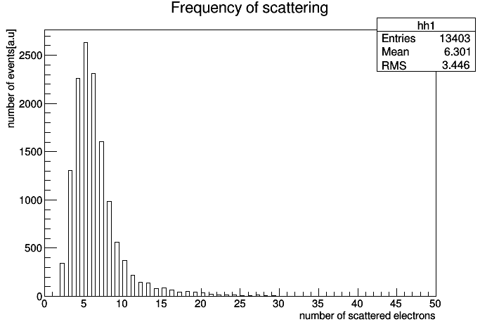
In the PET detectors, Compton scattering typically occur 1～6 times by one annihilation event. (3～8 electrons are scattered including photoelectric absorption)
It is important to detect where the first scattering position is.
Notes:
１回の電子陽電子対消滅事象に対して、検出器結晶内でのガンマ線のコンプトン散乱は１～６回程度起こる。

Slide 5
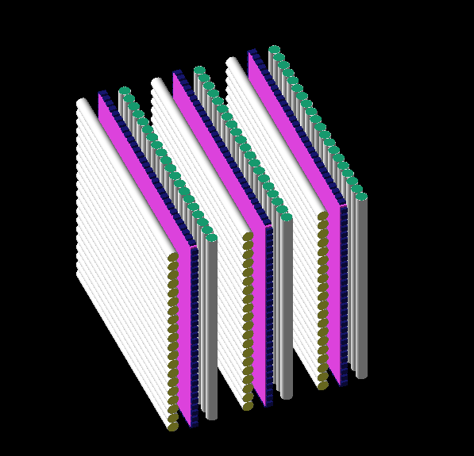
Structure of the detectors
plate-like La-GPS scintillators (34 mm ×34 mm × thickness of 3 mm)
La-GPS scintillator ･･･ (La,Gd)₂Si₂O₇(Ce)
WLS fibers (top and bottom surfaces of the scintillators, 0.2 mm in diameter)
→ Position detection of scattering
( WLS fiber ・・・ wavelength shifting fiber )
SiPM modules (lateral side of the scintillators,
3 mm ×3 mm )
→ Detection of energy deposit
( SiPM ・・・ Silicon Photomultiplier)
Notes:
シンチレータの上下面（この図では左右の面）に並べた波長変換ファイバーによって位置を検出
シンチレータの側面に貼ったSiPMによってエネルギーを検出

Slide 6
Energy deposit in the detectors
In approximately 4% of the whole e⁺・e⁻ annihilation events, the two gamma rays directly come into the detectors without being scattered in the patients’ bodies.
Even if the total energy deposit is high, there remains the possibility of Compton scattering in the detectors.
Notes:
コンプトン散乱しない事象は４％程度しか存在しない。

Slide 7
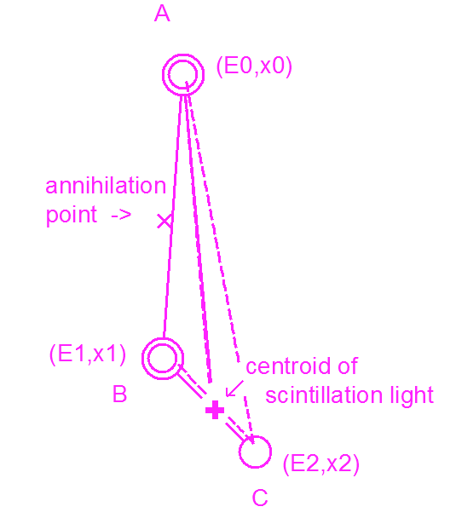
Analysis for Compton scattering events
Example : when the Compton scattering occurred one time
∠ABC and ∠ACB are compared with the energy deposit E0, E1 and E2 and then it is determined which is the first scattering point, B or C.
Conventionally, the centroid has been used as the data. It’s off the correct position.
Notes:
エネルギーのデータによって、最初のガンマ線散乱位置を特定。

Slide 8
Analysis for Compton scattering events
As a result of the simulation, in approximately 73% of Compton scattering events, the first scattering positions are correctly determined by calculating the energy discrepancy.
Notes:
73%のコンプトン散乱事象で最初の散乱位置を特定できた。

Slide 9
The number of events for cancer detection
1: Only photoelectric absorption events
2,3: number of events in which first scattering positions are correctly (less than 0.1 mm error) determined
2: by estimation of the centroid of scintillation lights
3: by calculating the energy discrepancy
Notes:
コンプトン散乱事象を適切に解析に用いれば、有効な事象数は10倍以上になる。これは、発光位置の重心を用いた解析よりも優れている。

Slide 10
Conclusion
If Compton scattering events are used as data for PET analysis, the data quantity is more than ten times as many as that of photoelectric absorption events.
If the energy discrepancy is calculated using the data of SiPM, the position accuracy improves compared with using the centroid of scintillation lights.
Notes:
コンプトン散乱事象を適切に解析に用いれば、有効な事象数は10倍以上になり、再構成画像の位置分解能向上につながる。

