Slide 1
Identification of ⁹⁰Sr/⁴⁰K based on Cherenkov Detector for Recovery from the Fukushima Nuclear Accident
H. Ito^{1*}, S. Han^{1,2}, N. Kaneko¹, H. Kawai¹, A. Kobayashi¹, M. Tabata¹
¹Graduat School of Science, Chiba University, Chiba, Japan
²Dept. of Accelerator and Medical Physics, National Institute of Radiological Sciences
Notes:
Thank you for my introduction. And, I'll talk about this title.

Slide 2
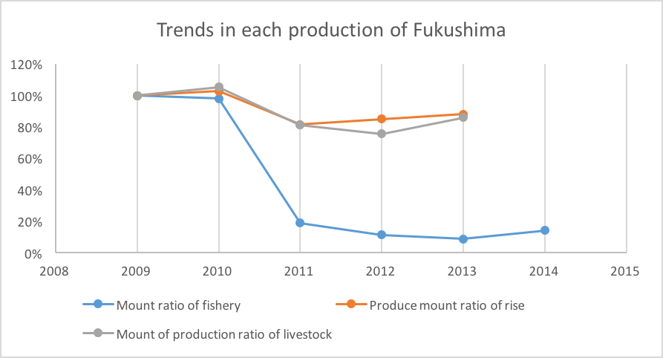
Introduction
445700
433900
541
513
382600
Problems
Fishery, contaminated water, decommissioning…
353600
368700
39442
38657
Unit: t
417
441
Unit: t
Fishery
2011/ 03/ 11 >> 2016/ 01/ 18
388
Unit: 10 MYen
7513
5644
4535
3461
Production agriculture income statistics in Fukushima,
Fukushima Prefectural Fisheries Department report, and
Ministry of Agriculture, Forestry and Fisheries, crops statistics
Notes:
We have passed five years since the Fukushima nuclear accident. Some people can not forget the impact, yet.
This graph shows produced mount ratio of agriculture, livestock and fishery in Fukushima. The fishery’s damage is grader, and even now, it has remained the damage.
In addition, we have same problems for the recovery. One of the reasons is about Sr-90. its radio activity is very difficult to measurer.

Slide 3
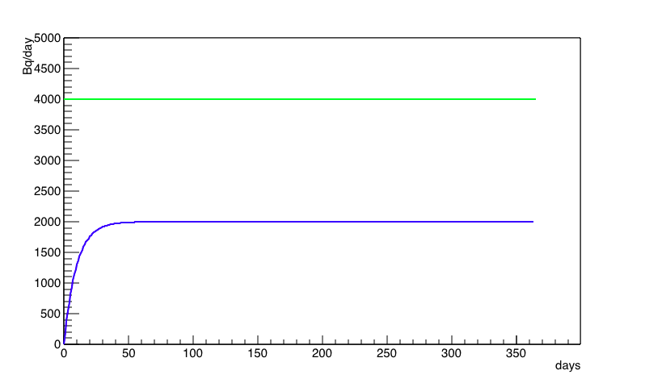
Introduction
Radioactivity in body everyday
Bq
¹³⁷Cs
⁴⁰K
Days
¹³⁷Cs limit: 100 Bq/kg
Decide as ⁴⁰K radioactivity
Notes:
You know that Japanese government defined as 100 Bq per kg of limit of radio-cesium in food, which the value is enough less than natural radioactivity of potassium-40 in our body.

Slide 4
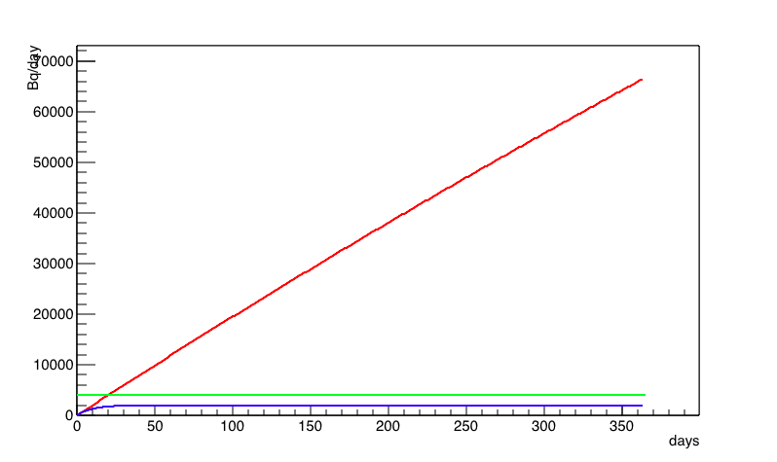
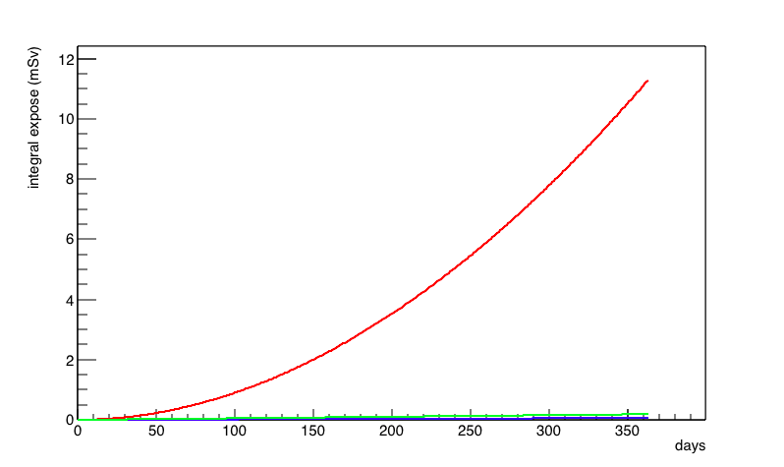
Introduction
Radioactivity in body everyday
Integral Exposures (mSv)
Bq
Bq
A year
¹³⁷Cs
⁴⁰K
⁹⁰Sr
¹³⁷Cs
⁴⁰K
⁹⁰Sr
¹³⁷Cs
⁴⁰K
Integral Exposure (mSv)
Days
Days
Days
⁹⁰Sr limit: no decided
If we take 100 Bq/kg ⁹⁰Sr …
- ⁹⁰Sr accumulates into the born.
- Integral exposure per year is more than natural radiation.
Notes:
However, the Sr-90 is not decided. If we take Sr-90 with the value same one of cesium limit, internal exposure is 100 times compared with cesium's exposure on the first year. So strontium-90 is more dangerous than radio-cesium.
Cesium and potassium are alkali metal, distribute in full body and leave out for 70 days. Strontium is alkali earth metal, accumulates into the born and stores for 18 years as half lifetime.

Slide 5
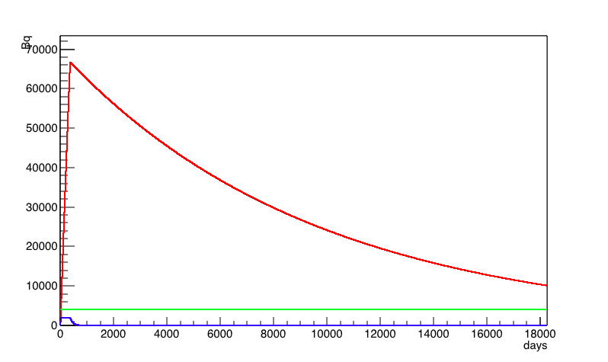
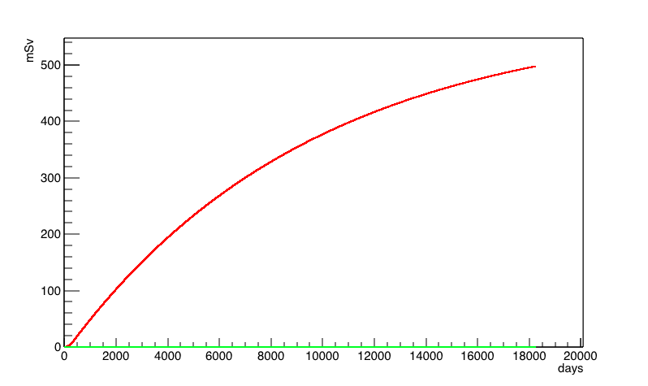
Introduction
Radioactivity in body everyday
Integral Exposures (mSv)
Bq
Bq
A years
50 years
A year
¹³⁷Cs
⁴⁰K
⁹⁰Sr
¹³⁷Cs
⁴⁰K
⁹⁰Sr
¹³⁷Cs
⁴⁰K
Integral Exposure (mSv)
Days
Days
Days
Lifelong exposure (50 years)
If it is perceive to take ⁹⁰Sr and stop…
Lifelong exposure (50 years) is calculated as 500 mSv.
Exposure up of 200 mSv means cancer risk with 1% up.
Notes:
Therefore, When the Sr-90 is taken for a year, lifelong exposure is calculated as 500 mSv. It is known that exposure increase of 200 mSv means cancer risk with 1% increase.

Slide 6
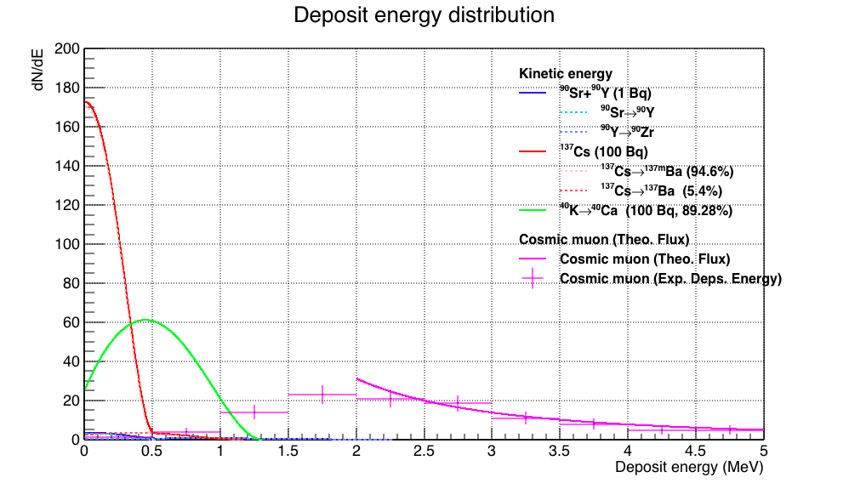
Introduction
Detection of deposit energy distribution
⁹⁰Sr limit should be decided less than 1 Bq/kg,
but measurement of the activity is difficult!
Using plastic scintillator with 1 cm thickness
Notes:
That is, radio-cesium is no problem in the limit of 100 Bq per kg. On the other hands, strontium-90 is more dangerous and its limit should be decided. However, its activity measurement is more difficult.
Because, beta-ray has continuous kinetic energy. And in conventional method of detection deposit energy, the higher energy beta-ray from yttrium-90 is hidden by natural radiation background.

Slide 7
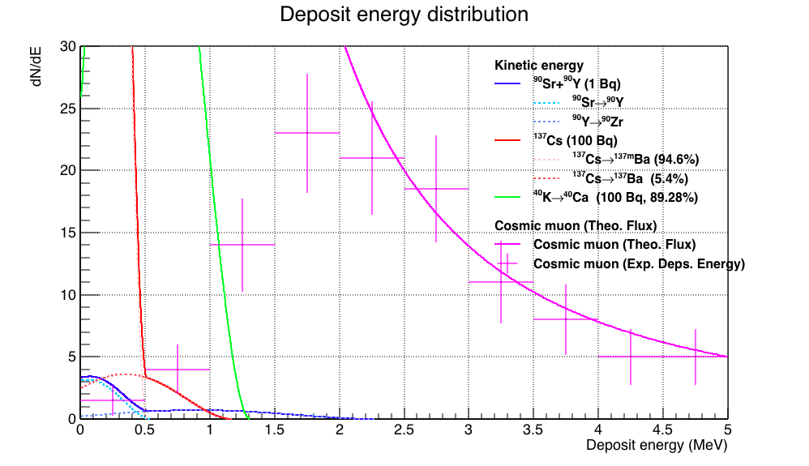
Introduction
Detection of deposit energy distribution
Using plastic scintillator with 1 cm thickness
Notes:
Cherenkov counter can identify only beta-ray from yttrium-90 in the lower energy background.

Slide 8
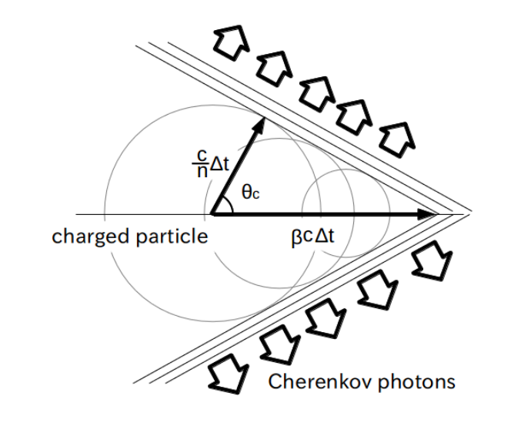
Cherenkov Radiation
Index: n
Cherenkov Radiation Condition:
β = v/c > 1/n
Threshold velocity ratio β_{th} (= v/c)：
β_{th} = 1/n_{th}
Notes:
Cherenkov radiation is a kind of shock wave. In a material with index of n, when a charged particle runs faster than photon, Cherenkov photon is emitted.
That is, the particle velocity is measured yes or no as over the threshold. By the method, the only beta-ray from Sr-90 can be detected in the background of potassium-40, cesium-137 or cosmic muons, and it is possible to measure Sr-90 activity.

Slide 9
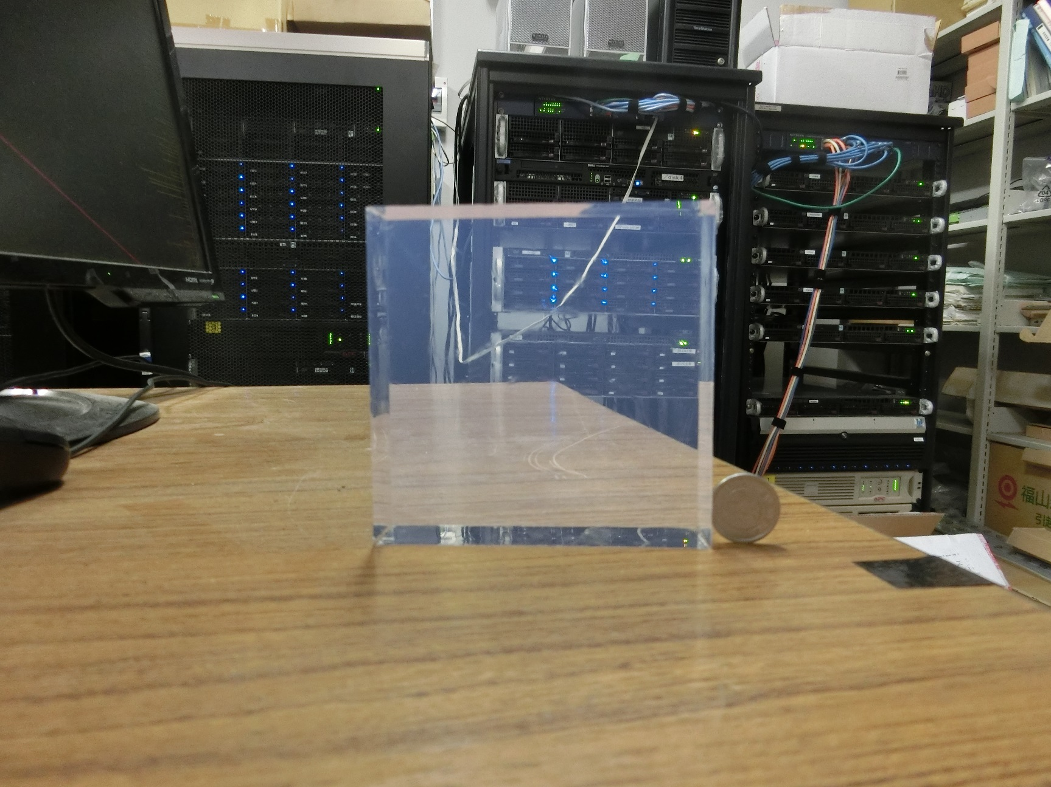
Silica Aerogel as Cherenkov radiator
Silica Aerogel
SiO₂ + Air
ref. index = 1.003 – 1.26
error: dn/(n - 1) < 0.01
Made in Chiba Univ.
Notes:
In order to determine threshold of refractive index, we use silica aerogel. Silica aerogel plays a role of mixtures with SiO2 and air. And the index is decided between 1.003 and 1.26 by the volume ratio.

Slide 10
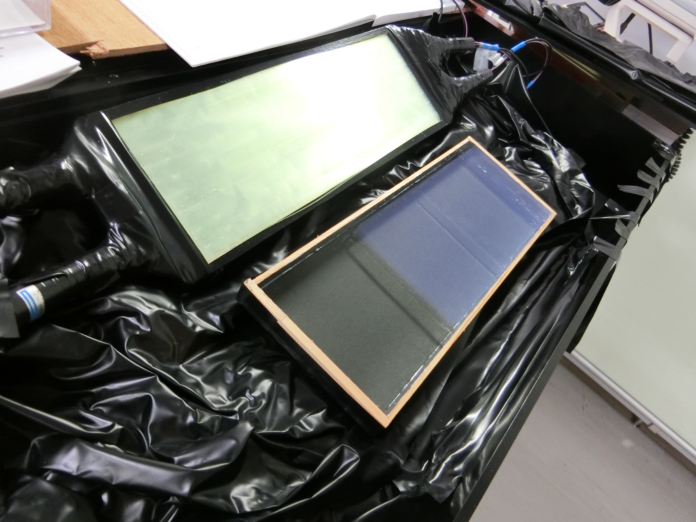
Prototype Counter
Readout by
Wavelength Shifting fiber (WLSF)
(type: B-3, Y-11)
PMT: R9880U-210
Insensitive for gamma-ray
Extend eff. area
Cost Down
Notes:
We produced a prototype counter using the silica aerogel. Cherenkov photon is observed by photomultiplier tubes via a light guide made from wavelength shifting fibers. Comparing with direct read out PMT, it is enable that suppression of gamma-ray noise, extending effective area and cost down.

Slide 11
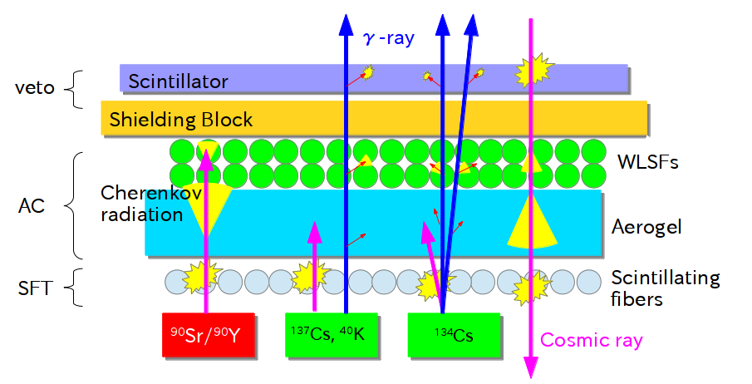
Prototype Counter
Prototype Counter Diagram
Logic to identify ⁹⁰Sr
 | ⁹⁰Sr | ¹³⁷Cs | ⁴⁰K | muon
veto | - | - | - | ⚪︎
AC | ⚪︎ | - | - | ⚪︎
SFT | ⚪︎ | ⚪︎ | ⚪︎ | ⚪︎
Notes:
The prototype counter overview is shown in this slide. This counter consists of trigger window made from scintillating fibers, Cherenekov counter using silica aerogel, shielding block and scintillation counter for suppression of cosmic muons. The sample sets under the counter. In the case of SFT and AC is reaction and veto is not reaction, this event means detection of beta-ray from yttorium-90.

Slide 12
⁹⁰Sr/¹³⁷Cs Identification
Notes:
About identification of Sr-90 and Cs137.

Slide 13
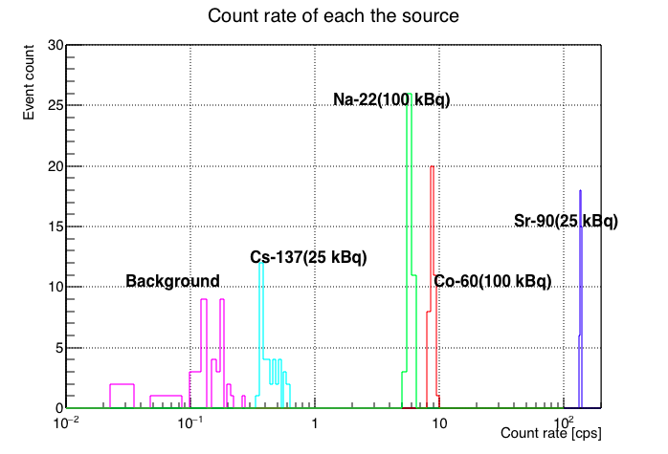
⁹⁰Sr/¹³⁷Cs Identification
How to estimate…
required index (n < 1.0492)
using active source ⁹⁰Sr, ¹³⁷Cs, other γ-ray source
aerogel with n = 1.04497 ± 0.00006
Sensitivity definition
η = (R - R_{BG})/A ,
where
R: Count rate (counts/sec)
R_{BG}: Background rate (counts/sec)
A: Radioactivity (Bq)
Sensitivity Ratio
Γ(Cs/Sr) = η(¹³⁷Cs)/η(⁹⁰Sr)
Result:
η(Sr) = (5.49 ± 0.06) ×10⁻³ Hz/Bq
Γ(Cs/Sr) = (2.0 ± 1.2) ×10⁻³
H. Ito et al., TIPP (2014)
Notes:
In order not to react beta-ray from Cs-137, it is required index less than 1.0492. We used the aerogel with index of 1.045, and aimed to measure.
The method is simple. Radioactive source was set on the counter, the sensitivity is led from effective count rate and source activity.
As the results, Sr-90 sensitivity of 5 by 10 to the minas 3rd power Hz per Bq and the ratio of 0.2% are obtained.

Slide 14
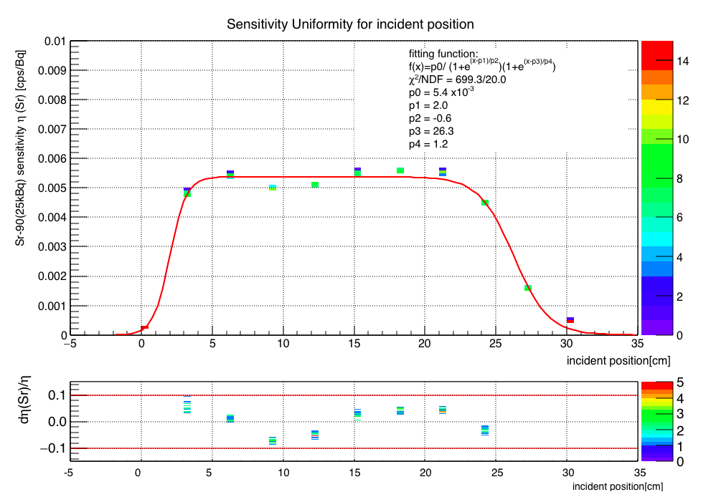
⁹⁰Sr/¹³⁷Cs Identification
How to estimate…
required index (n < 1.0492)
using active source ⁹⁰Sr, ¹³⁷Cs, other γ-ray source
aerogel with n = 1.04497 ± 0.00006
Sensitivity uniformity
σ_{st} < 10%
Effective area = 300 × 100 mm²
Sensitive area = 243 × 100 mm²
H. Ito et al., TIPP (2014)
H. Ito et al., ANIMMA (2015)
Notes:
And, on the effective area of 30 cm by 10 cm, the Sr-90 source is put on the counter moving incident position. As the result, standard deviation fluctuation less than 10% was demonstrated and sensitive area was proved to 24 cm by 10 cm.

Slide 15
⁹⁰Sr/⁴⁰K Identification
Notes:
Next, about identification of Sr-90 and potassium-40.

Slide 16
⁹⁰Sr/⁴⁰K Identification
How to estimate…
required index (n < 1.0418)
using active source ⁹⁰Sr, ⁴⁰K
aerogel with n = 1.03443 ± 0.00006
How to get ⁴⁰K source?
Notes:
In this time, in order not to react beta-ray from potassium-40, it is required the index less than 1.0418. We aimed to measure using the aerogel with index of 1.035.
However, how we get potassium-40 source?

Slide 17
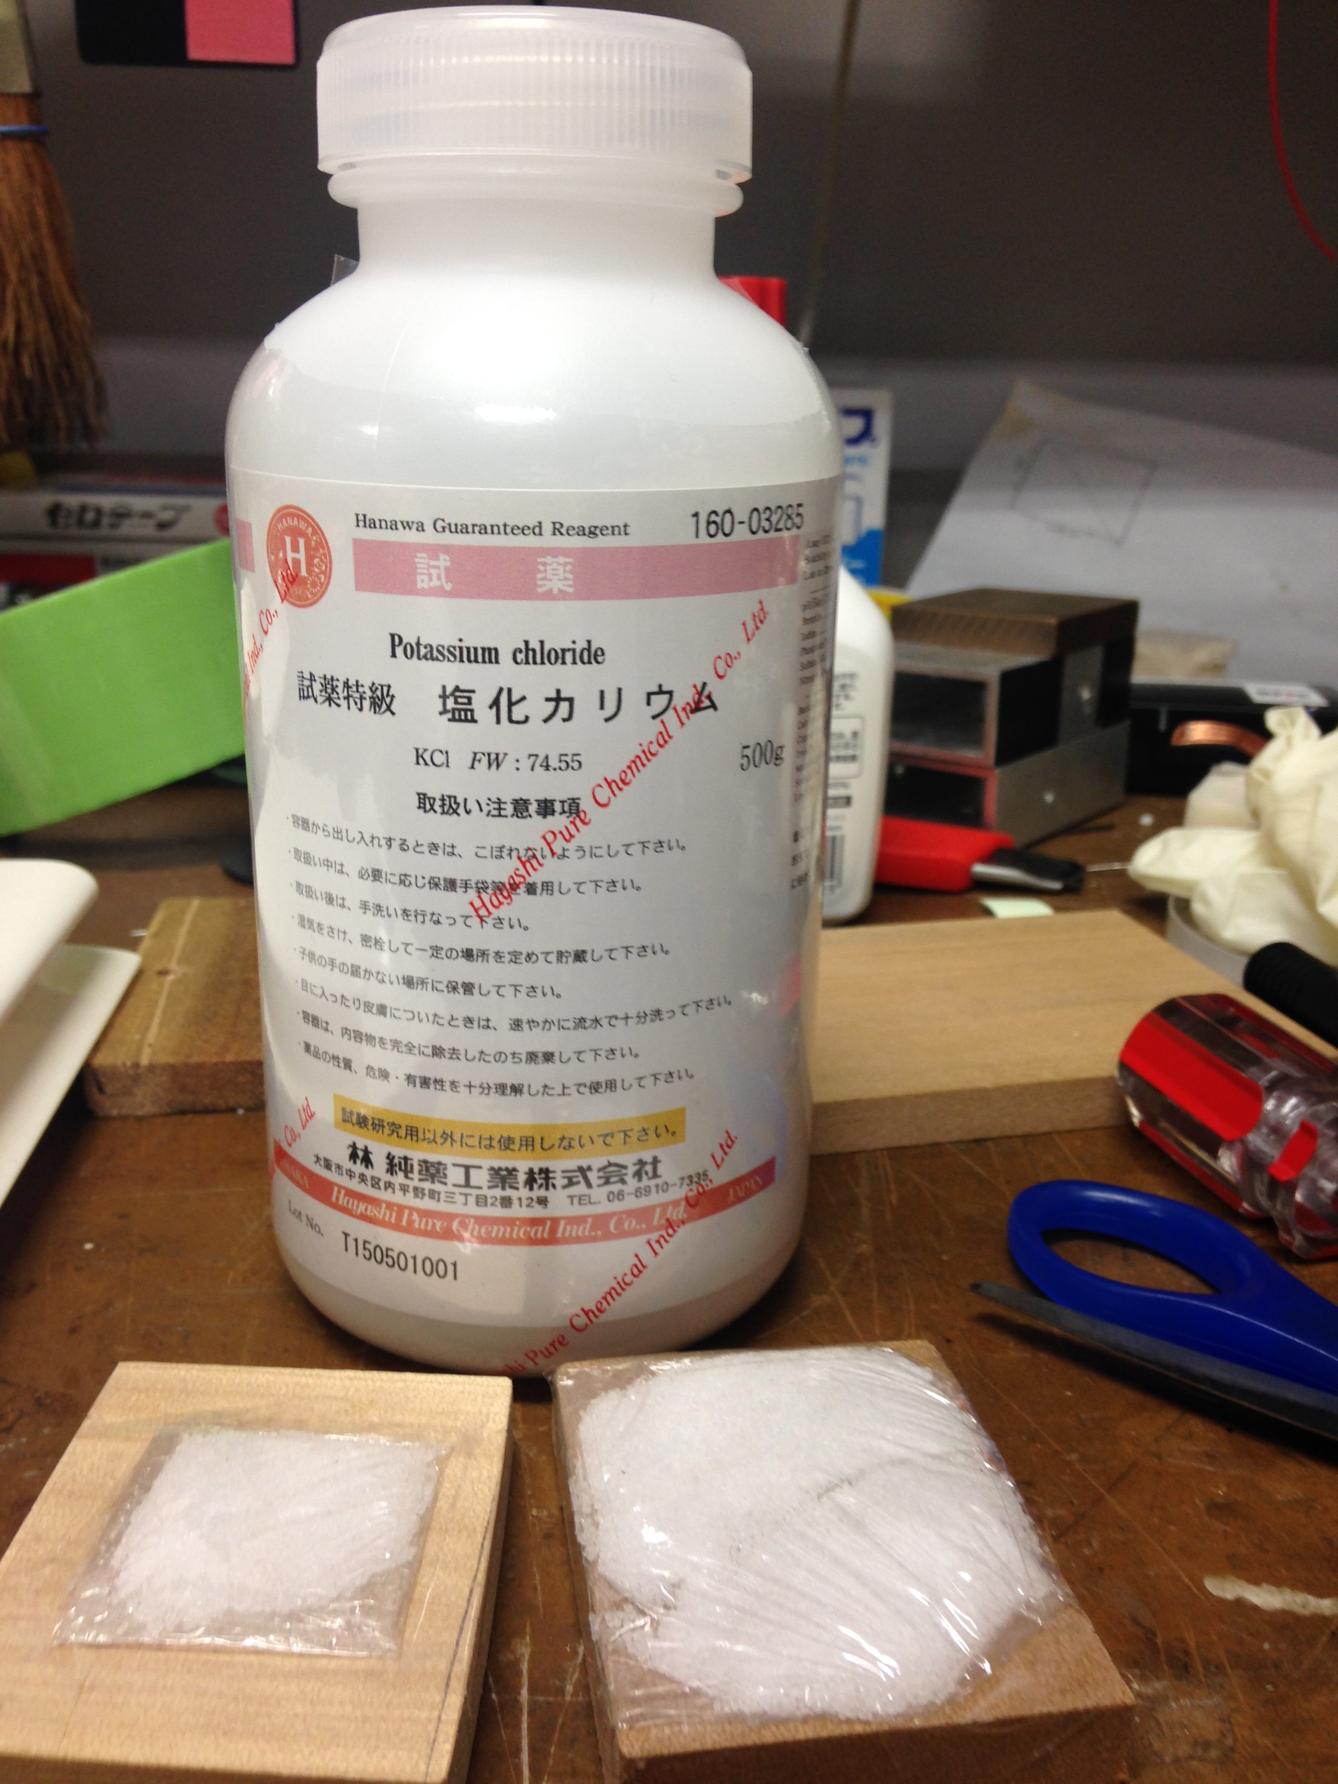
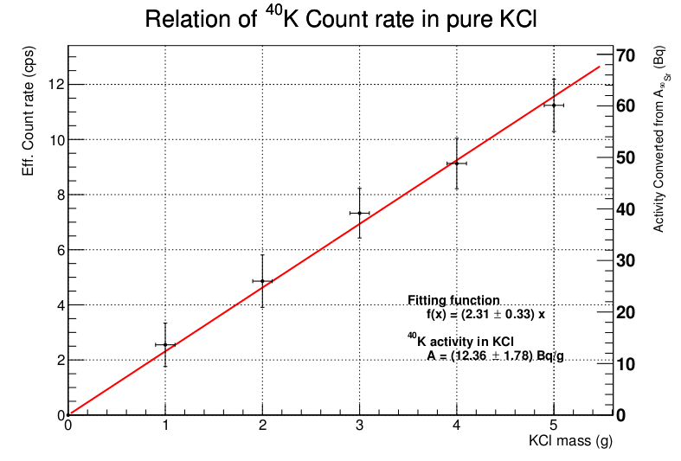
How to get ⁴⁰K source?
⁴⁰K … 0.012% in nature potassium
>> Pure KCl has 16.6 Bq/g
Eff. Count rate(cps)
Activity calibrated from ⁹⁰Sr (Bq)
KCl mass(g)
Notes:
So, potassium-40 is about 0.012% in natural potassium. For mass stable, we used pure potassium chloride, which has 16.6 Bq per gram.
And experimental relation was confirmed by scintillation counter. Therefore, enable as potassium-40 source was proved.

Slide 18
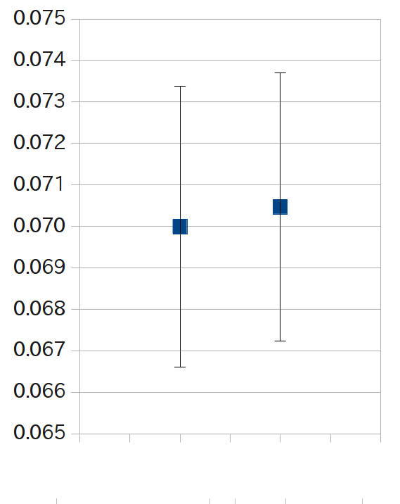
⁹⁰Sr/⁴⁰K Identification
Raw data
BG |  |  | KCl |  |  |  |  | Sr
sec | count |  | g | Bq | sec | count |  | Bq | sec | count
1228 | 64 |  | 1 | 16.66 | 1751 | 127 |  | 2.68E+04 | 10 | 497
1221 | 91 |  | 2 | 33.2 | 1243 | 89 |  | 2.68E+04 | 10 | 536
1229 | 91 |  | 3 | 49.8 | 1233 | 89 |  | 2.68E+04 | 10 | 505
1202 | 86 |  | 4 | 66.4 | 1296 | 99
1221 | 95 |  | 5 | 83.0 | 1232 | 72
count rate
(7.00 ± 0.34) x 10⁻² Hz |  | (7.05 ± 0.32) x 10⁻² Hz |  | 51.3 ± 1.3 Hz
(7.00 ± 0.34) x 10⁻² Hz |  | (7.05 ± 0.32) x 10⁻² Hz |  | 51.3 ± 1.3 Hz
⁴⁰K was not observed the deviation of BG.
BG
⁴⁰K
Notes:
About the potassium-40, it is measured same of cesium-137. The raw data is shown in the list.
The potassium-40 was not observed the deviation significantly the error in the background.

Slide 19
⁹⁰Sr/⁴⁰K Identification
Raw data
BG |  |  | KCl |  |  |  |  | Sr
sec | count |  | g | Bq | sec | count |  | Bq | sec | count
1228 | 64 |  | 1 | 16.66 | 1751 | 127 |  | 2.68E+04 | 10 | 497
1221 | 91 |  | 2 | 33.2 | 1243 | 89 |  | 2.68E+04 | 10 | 536
1229 | 91 |  | 3 | 49.8 | 1233 | 89 |  | 2.68E+04 | 10 | 505
1202 | 86 |  | 4 | 66.4 | 1296 | 99
1221 | 95 |  | 5 | 83.0 | 1232 | 72
count rate
(7.00 ± 0.34) x 10⁻² Hz |  | (7.05 ± 0.32) x 10⁻² Hz |  | 51.3 ± 1.3 Hz
(7.00 ± 0.34) x 10⁻² Hz |  | (7.05 ± 0.32) x 10⁻² Hz |  | 51.3 ± 1.3 Hz
(7.00 ± 0.34) x 10⁻² Hz |  | (7.05 ± 0.32) x 10⁻² Hz |  | 51.3 ± 1.3 Hz
⁹⁰Sr sensitivity η(Sr) = (R - R_{BG})/A_{Sr}
= (1.91 ± 0.89) × 10⁻³ Hz/Bq
Limited = ΔR_{BG}/η(Sr)
= 1.78 Bq
Limited = ΔR_{BG}/η(Sr)
= 1.78 Bq
BG
⁴⁰K
Γ(⁹⁰Sr/⁴⁰K) < Limited/ η(Sr)
= 3.5 × 10⁻²
Notes:
Sr-90 sensitivity is calculated this value by the formula.
And the detection limit of Sr-90 is obtained 1.78 Bq for this prototype counter.
As the result, it is found that the ratio of potassium-40 and Sr-90 less than 3.5%.

Slide 20
Result
⁹⁰Sr/⁴⁰K Identification
Using aerogel with n = 1.03443 ± 0.00006
Sensitivity
η(Sr) = (1.91 ± 0.89) × 10⁻³ Hz/Bq
Limited = 1.78 Bq
Sensitivity Ratio
Γ(K/Sr) < 3.5 × 10⁻²
For precise measurement
More ⁴⁰K activity
>> Extend effective area
Notes:
In this time, we aimed to measure the sensitivity of Sr-90 and potassium-40 using aerogel with index of 1.035, for the prototype counter.
Potassium-40 was not observed the deviation significantly the background error, because potassium-40 activity is a little and BG rate is larger, yet.
For the improving that, the prototype counter's effective area should be extended, and BG should be suppressed.
It is successfully to make the prototype counter with sensitivity of only Sr-90, but the performance is not enough. we would improve it.

Slide 21
Applying for the Recovery
For Fishery
Counter
Useable Everyone
[1 hr measurement]
Result Soon
For Example
Anywhere Measurement
K
Sr
K
Lower Cost
K
K
K
Thinner sample of the born
Result
OK or NG for Selling
Notes:
Here, we propose 3 ideas for the recovery of Fukushima, using the identification technology.
First, for the fishery restart. Getting fish fillet is made to paste, and measured Sr-90 activity, which the fillet has almost its born. The measurement is finished soon for keeping flesh and decided OK or NG before celling.
It is important for this counter that, simply useable everyone, result output soon, anywhere measurement without controlled area and lower cost for unit of sample.

Slide 22
Applying for the Recovery
For Fishery
Counter
Useable Everyone
[1 hr measurement]
Result Soon
For Example
Anywhere Measurement
K
Sr
K
Lower Cost
K
K
K
Thinner sample of the born
Result
OK or NG for Selling
Notes:
Here, we propose 3 ideas for the recovery of Fukushima, using the technology.
First, for the fishery restart. Getting fish born is made to paste, and measured Sr-90 activity. The measurement is finished soon for keeping flesh and decided OK or NG before celling.
It is important for this counter that simply useable everyone, result output soon, anywhere measurement without controlled area and lower cost for unit of sample.

Slide 23
Applying for the Recovery
For tap water
Ararat and stop supply
For Example
⁹⁰Sr activity
Online Monitor
Notes:
Second, For the drinking water. The Cherenkov counter can decide yes or no, and monitor online.
When the counter observed Sr-90, it alerts and stops supply. In Europe, it is reported plan that water works bureau checks alpha, beta and gamma-ray detection everyday, for home security.
In addition, this monitor would be applied to check removed contaminated water.

Slide 24
Applying for the Recovery
For commissioning
Debris
Sr
Ru
Cooling water = contaminated
For Example
Debris Scanner in contaminated water
Melt Downed
Nuclear reactor
U(n, f) ¹⁰⁶RU
¹⁰⁶Ru -> ¹⁰⁶Rh -> ¹⁰⁶Pb
β_{max} = 0.039 MeV
β_{max} = 3.54 MeV
τ_{1/2} = 373 days
τ_{1/2} = 29 sec
¹⁰⁶Ru/⁹⁰Sr Identification
Required index n<1.017
Notes:
Third, about debris scanner for commissioning the melt downed reactor. In the melt downed reactor basically, the debris are in cooling water, which water has much of Sr-90.
And the debris have rutenium-106 from Uranium. So, in order not to react the beta-ray from yttorium-90, it is required the index less than 1.017. So, it is possible by this identification technology.

Slide 25
Summary
Development of Cherenkov Counter
⁹⁰Sr/¹³⁷Cs sensitivity ratio = 0.2 ± 0.12%
⁹⁰Sr/⁴⁰K sensitivity ratio < 3.5%
For precise measurement: extend eff. Area
For the recovery using the technique
Fishery restart
Tap water radionuclide monitor
Debris scanner for commissioning
Notes:
Lastly, we have developed Cherenkov counter for identification of radionuclide. It is successfully to identify Sr-90 in solvable radionuclides and natural radiation.
And we have proposed 3 ideas for the Fukushima recovery. I think that this technology is one of the approach to advance the recovery, and this technology would be to practical application.

Slide 26
Thank you
Notes:
Thank you.

Slide 27
Backup

Slide 28
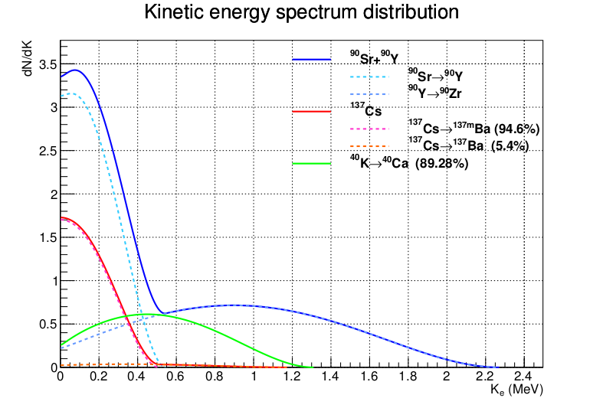
Is It Difficult to Measure ⁹⁰Sr?
Threshold kinetic energy：
K_{th} = 1.311 MeV
That is, threshold index：
n_{th} = 1.0418
Threshold velocity ratio β_{th} (= v/c)：
β_{th} = 1/n_{th}

Slide 29
Is It Difficult to Measure ⁹⁰Sr?
Threshold kinetic energy：
K_{th} = 1.311 MeV
That is, threshold index：
n_{th} = 1.0418
Threshold velocity ratio β_{th} (= v/c)：
β_{th} = 1/n_{th}

